Slide 1
Human Influences on Climate

Slide 2
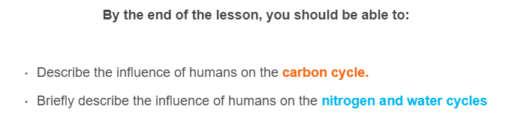
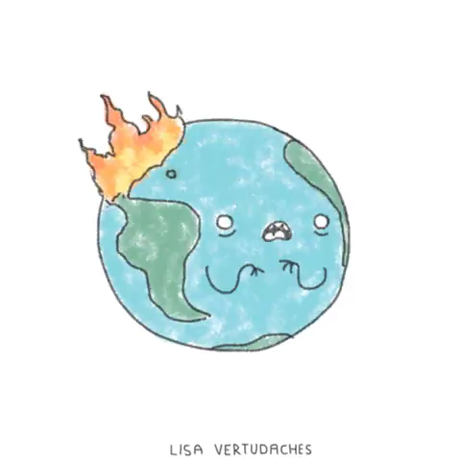

Slide 3
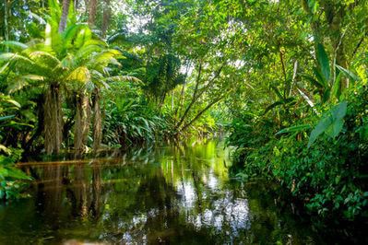
Unsurprisingly, deforestation has a massive effect on the carbon cycle and the climate.
Deforestation refers to cutting down trees, usually in large amounts, with the goal of clearing space for human expansion, rather than regrowth.

Slide 4
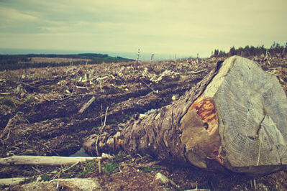
Rainforests absorb huge amounts of carbon dioxide through photosynthesis. This process stores the carbon and produces oxygen.
As we cut down rainforests, we remove this carbon dioxide sink. As the wood is burnt or decomposed, the stored carbon is released into the atmosphere.

Slide 5
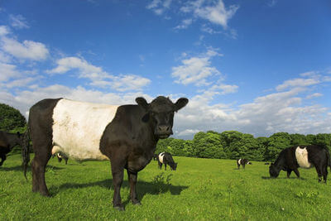
Agriculture also significantly contributes to the release of greenhouse gases.
Cows and sheep produce methane as they digest grass. In countries that have large livestock industries, this can account for significant amounts of their methane emissions.
Livestock produce 37% of Australia's methane emissions and 90% of New Zealand's!

Slide 6
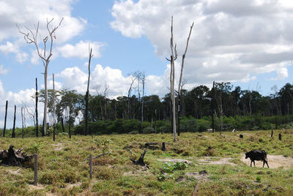
Deforestation is often carried out to make way for more cattle pastures. This means we are replacing a carbon sink with a carbon source!
Trees absorb carbon through photosynthesis. Livestock produce carbon through digesting grass.

Slide 7
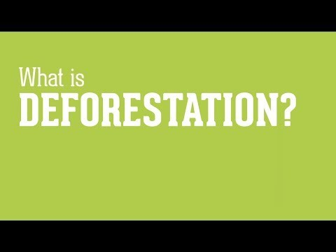

Slide 8
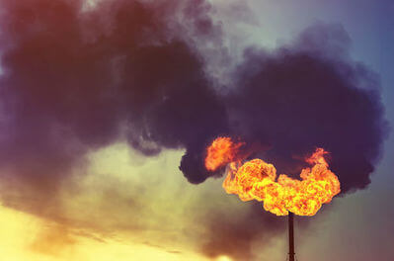
Fossil fuels contain carbon which has been stored in the lithosphere for millennia.
By burning them, we are releasing huge amounts carbon into the atmosphere, which will take millions of years to return to the lithosphere.

Slide 9
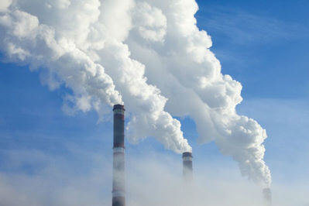
Roughly half of the carbon dioxide produced by burning fossil fuels is not reabsorbed by natural processes and remains in the atmosphere.

Slide 10
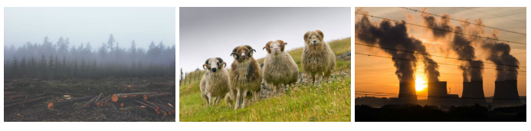
Humans are producing more atmospheric carbon than the carbon cycle can remove. We are creating new carbon sources and removing carbon sinks.
This causes more carbon to build up in the atmosphere, which intensifies the enhanced greenhouse effect.

Slide 11
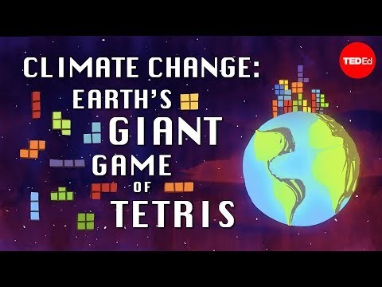

Slide 12
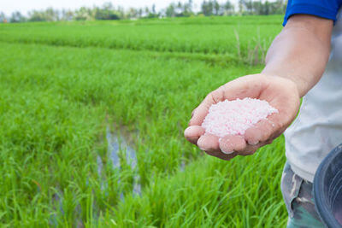
Most of the nitrogen in the nitrogen cycle is found in the atmosphere, as inert molecular nitrogen (N₂​). Since the development of the Haber process, humans have been shifting this balance.
The Haber process converts molecular nitrogen into ammonia, mainly for use in fertilisers.

Slide 13
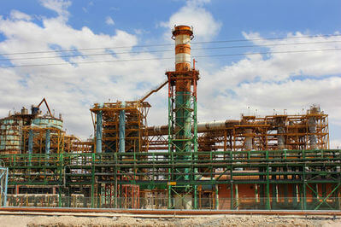
Fertiliser use increases the amount of nitrogen in the biosphere and lithosphere. This speeds up the natural processes that produce nitrous oxide.
About 40% of nitrous oxide emissions are attributed to human activities, mostly farming.

Slide 14
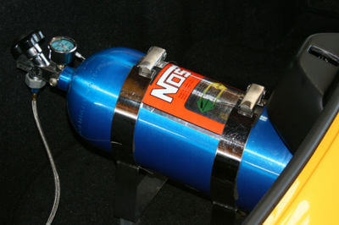
Nitrous oxide (N_{2​}O) is a greenhouse gas that warms the earth nearly 300 times as effectively as carbon dioxide!
You may know this chemical by the name laughing gas or NOS.

Slide 15


Slide 16
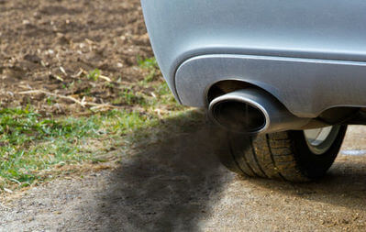
Nitrogen oxides (NO_{x}​) are produced during the combustion of fossil fuels. These are the chemicals that lead to smog and acid rain.
Fortunately, thanks to special filters we've added to our exhaust pipes, NO_{x​} concentrations in the atmosphere have been steadily decreasing.

Slide 17
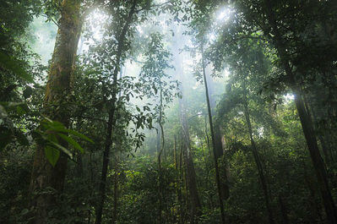
Plants produce water vapour in a process called transpiration. This water vapour accumulates in the atmosphere and contributes to rainfall.
This is why rainforests are called rainforests! They contain so many trees that transpiration causes substantial amounts of rainfall in the area.

Slide 18
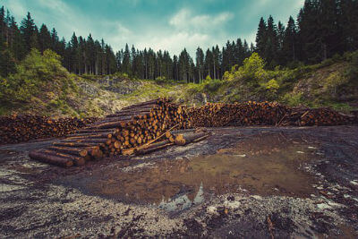
Deforestation will affect the amount of rainfall in the surrounding areas. As more and more trees are cut down, wet areas will become increasingly dry.
This impacts the entire local ecosystem, which includes the humans living in the area.

Slide 19


Rainfall has a major impact on humans. We use water for drinking, agriculture, industry processes and leisure.
The less rainfall an area receives, the less water there is available for these uses.

